Slide 1
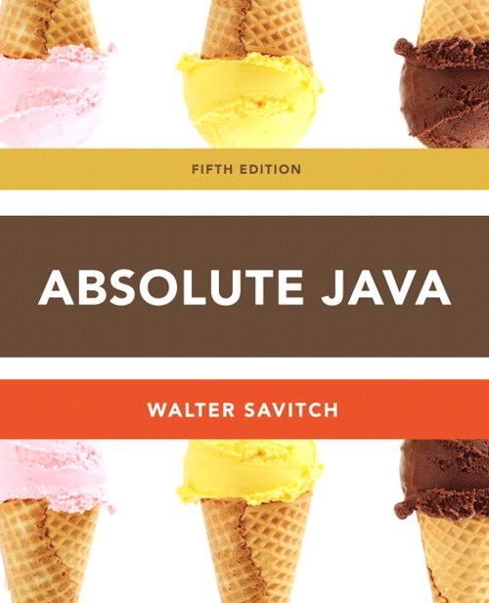
Chapter 3
Loops
Section 3.3
Slides prepared by Rose Williams, Binghamton University
Kenrick Mock, University of Alaska Anchorage

Slide 2
Loops
Loops in Java are similar to those in other high-level languages
Java has three types of loop statements: the while, the do-while, and the for statements
The code that is repeated in a loop is called the body of the loop
Each repetition of the loop body is called an iteration of the loop

Slide 3
while statement
A while statement is used to repeat a portion of code (i.e., the loop body) based on the evaluation of a Boolean expression
The Boolean expression is checked before the loop body is executed
When false, the loop body is not executed at all
Before the execution of each following iteration of the loop body, the Boolean expression is checked again
If true, the loop body is executed again
If false, the loop statement ends
The loop body can consist of a single statement, or multiple statements enclosed in a pair of braces ({ })

Slide 4
while Syntax
while (Boolean_Expression)
Statement
Or
while (Boolean_Expression){
Statement_1
Statement_2
Statement_Last
}
. . .

Slide 5
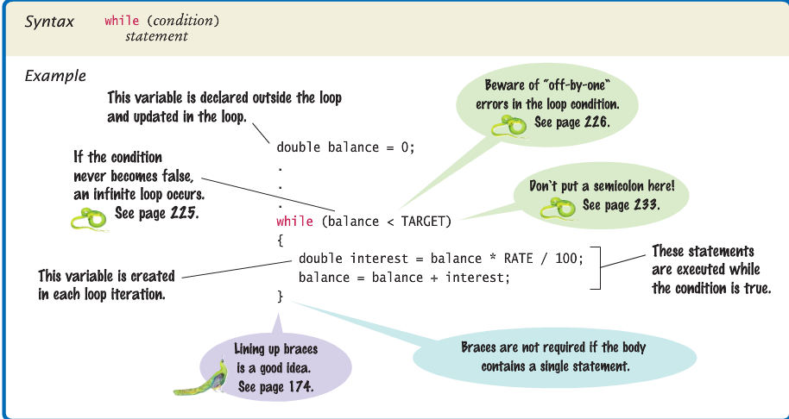
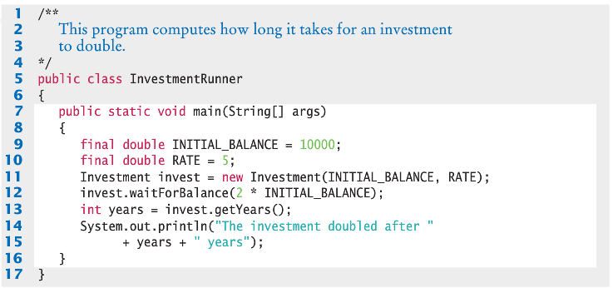
while statement

Slide 6
do-while Statement
A do-while statement is used to execute a portion of code (i.e., the loop body), and then repeat it based on the evaluation of a Boolean expression
The loop body is executed at least once
The Boolean expression is checked after the loop body is executed
The Boolean expression is checked after each iteration of the loop body
If true, the loop body is executed again
If false, the loop statement ends
Don't forget to put a semicolon after the Boolean expression
Like the while statement, the loop body can consist of a single statement, or multiple statements enclosed in a pair of braces ({ })

Slide 7
do-while Syntax
do
Statement
while (Boolean_Expression);
Or
do {
Statement_1
Statement_2
Statement_Last
} while (Boolean_Expression);
. . .

Slide 8
Algorithms and Pseudocode
The hard part of solving a problem with a computer program is not dealing with the syntax rules of a programming language
Rather, coming up with the underlying solution method is the most difficult part
An algorithm is a set of precise instructions that lead to a solution
An algorithm is normally written in pseudocode, which is a mixture of programming language and a human language, like English
Pseudocode must be precise and clear enough so that a good programmer can convert it to syntactically correct code
However, pseudocode is much less rigid than code: One needn't worry about the fine points of syntax or declaring variables, for example

Slide 9
The for Statement
The for statement is most commonly used to step through an integer variable in equal increments
It begins with the keyword for, followed by three expressions in parentheses that describe what to do with one or more controlling variables
The first expression tells how the control variable or variables are initialized or declared and initialized before the first iteration
The second expression determines when the loop should end, based on the evaluation of a Boolean expression before each iteration
The third expression tells how the control variable or variables are updated after each iteration of the loop body

Slide 10
The for Statement Syntax
for (Initializing; Boolean_Expression; Update)
Body
The Body may consist of a single statement or a list of statements enclosed in a pair of braces ({ })
Note that the three control expressions are separated by two, not three, semicolons
Note that there is no semicolon after the closing parenthesis at the beginning of the loop

Slide 11
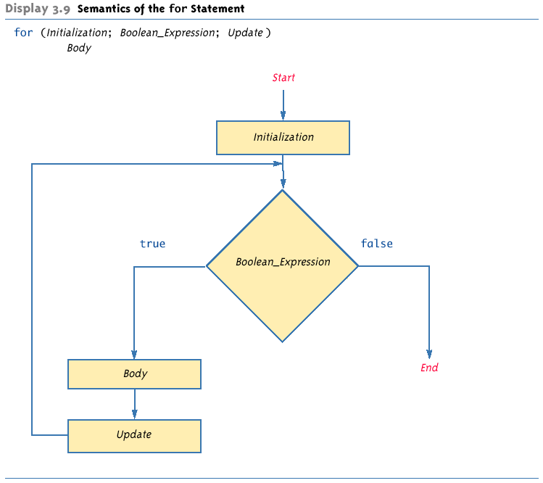
Semantics of the for Statement

Slide 12
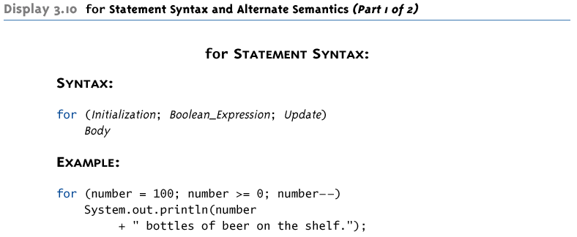
for Statement Syntax and Alternate Semantics

Slide 13
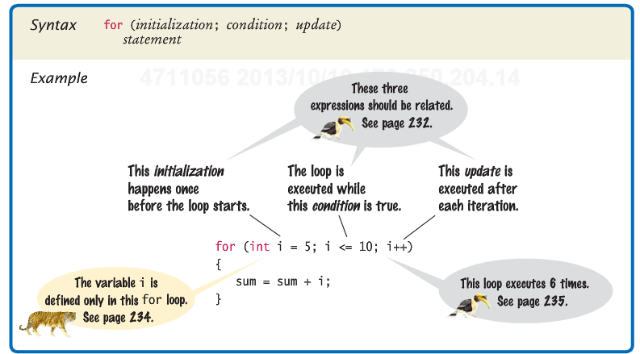
The for Statement

Slide 14
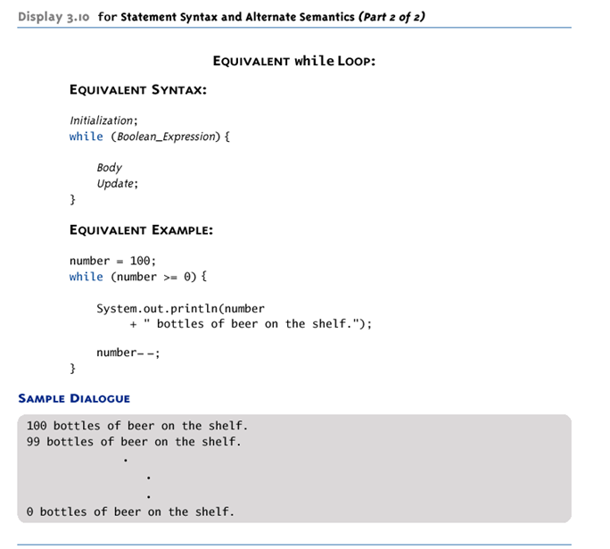
for Statement Syntax and Alternate Semantics

Slide 15
The Comma in for Statements
A for loop can contain multiple initialization actions separated with commas
Caution must be used when combining a declaration with multiple actions
It is illegal to combine multiple type declarations with multiple actions, for example
To avoid possible problems, it is best to declare all variables outside the for statement
A for loop can contain multiple update actions, separated with commas, also
It is even possible to eliminate the loop body in this way
However, a for loop can contain only one Boolean expression to test for ending the loop

Slide 16
Infinite Loops
A while, do-while, or for loop should be designed so that the value tested in the Boolean expression is changed in a way that eventually makes it false, and terminates the loop
If the Boolean expression remains true, then the loop will run forever, resulting in an infinite loop
Loops that check for equality or inequality (== or !=) are especially prone to this error and should be avoided if possible

Slide 17
Nested Loops
Loops can be nested, just like other Java structures
When nested, the inner loop iterates from beginning to end for each single iteration of the outer loop
int rowNum, columnNum;
for (rowNum = 1; rowNum <=3; rowNum++) {
for (columnNum = 1; columnNum <=2; columnNum++)
System.out.print(" row " + rowNum +
" column " + columnNum);
System.out.println();
}
row 1 column 1
row 1 column 2
row 2 column 1
row 2 column 2
row 3 column 1
row 3 column 2

Slide 18
The break and continue Statements
The break statement consists of the keyword break followed by a semicolon
When executed, the break statement ends the nearest enclosing switch or loop statement
The continue statement consists of the keyword continue followed by a semicolon
When executed, the continue statement ends the current loop body iteration of the nearest enclosing loop statement
Note that in a for loop, the continue statement transfers control to the update expression
When loop statements are nested, remember that any break or continue statement applies to the innermost, containing loop statement

Slide 19
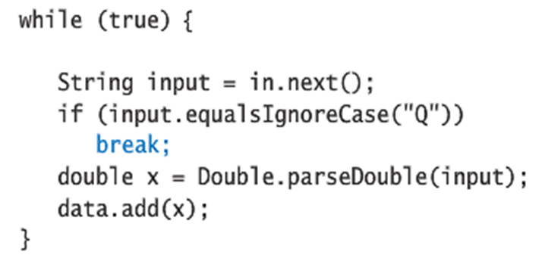
The break Statement
Infinite conditional loops NOT recommended as shown above.

Slide 20
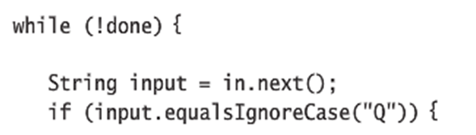
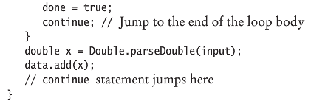
The continue Statement

Slide 21
The Labeled break Statement
There is a type of break statement that, when used in nested loops, can end any containing loop, not just the innermost loop
If an enclosing loop statement is labeled with an Identifier, then the following version of the break statement will exit the labeled loop, even if it is not the innermost enclosing loop:
break someIdentifier;
To label a loop, simply precede it with an Identifier and a colon:
someIdentifier:

Slide 22
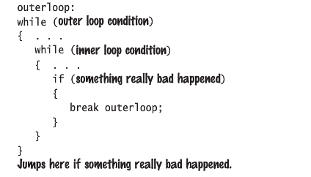
The Labeled break Statement

Slide 23
The exit Statement
A break statement will end a loop or switch statement, but will not end the program
The exit statement will immediately end the program as soon as it is invoked:
System.exit(0);
The exit statement takes one integer argument
By tradition, a zero argument is used to indicate a normal ending of the program

